Slide 1
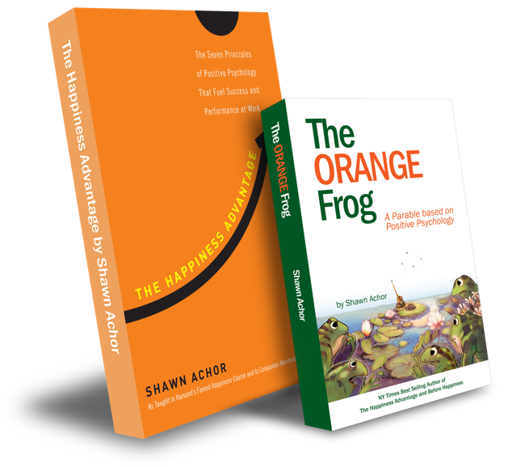
The Happiness Advantage
and
The Orange Frog
By Shawn Achor

Slide 2
Elementary Week One

Slide 3
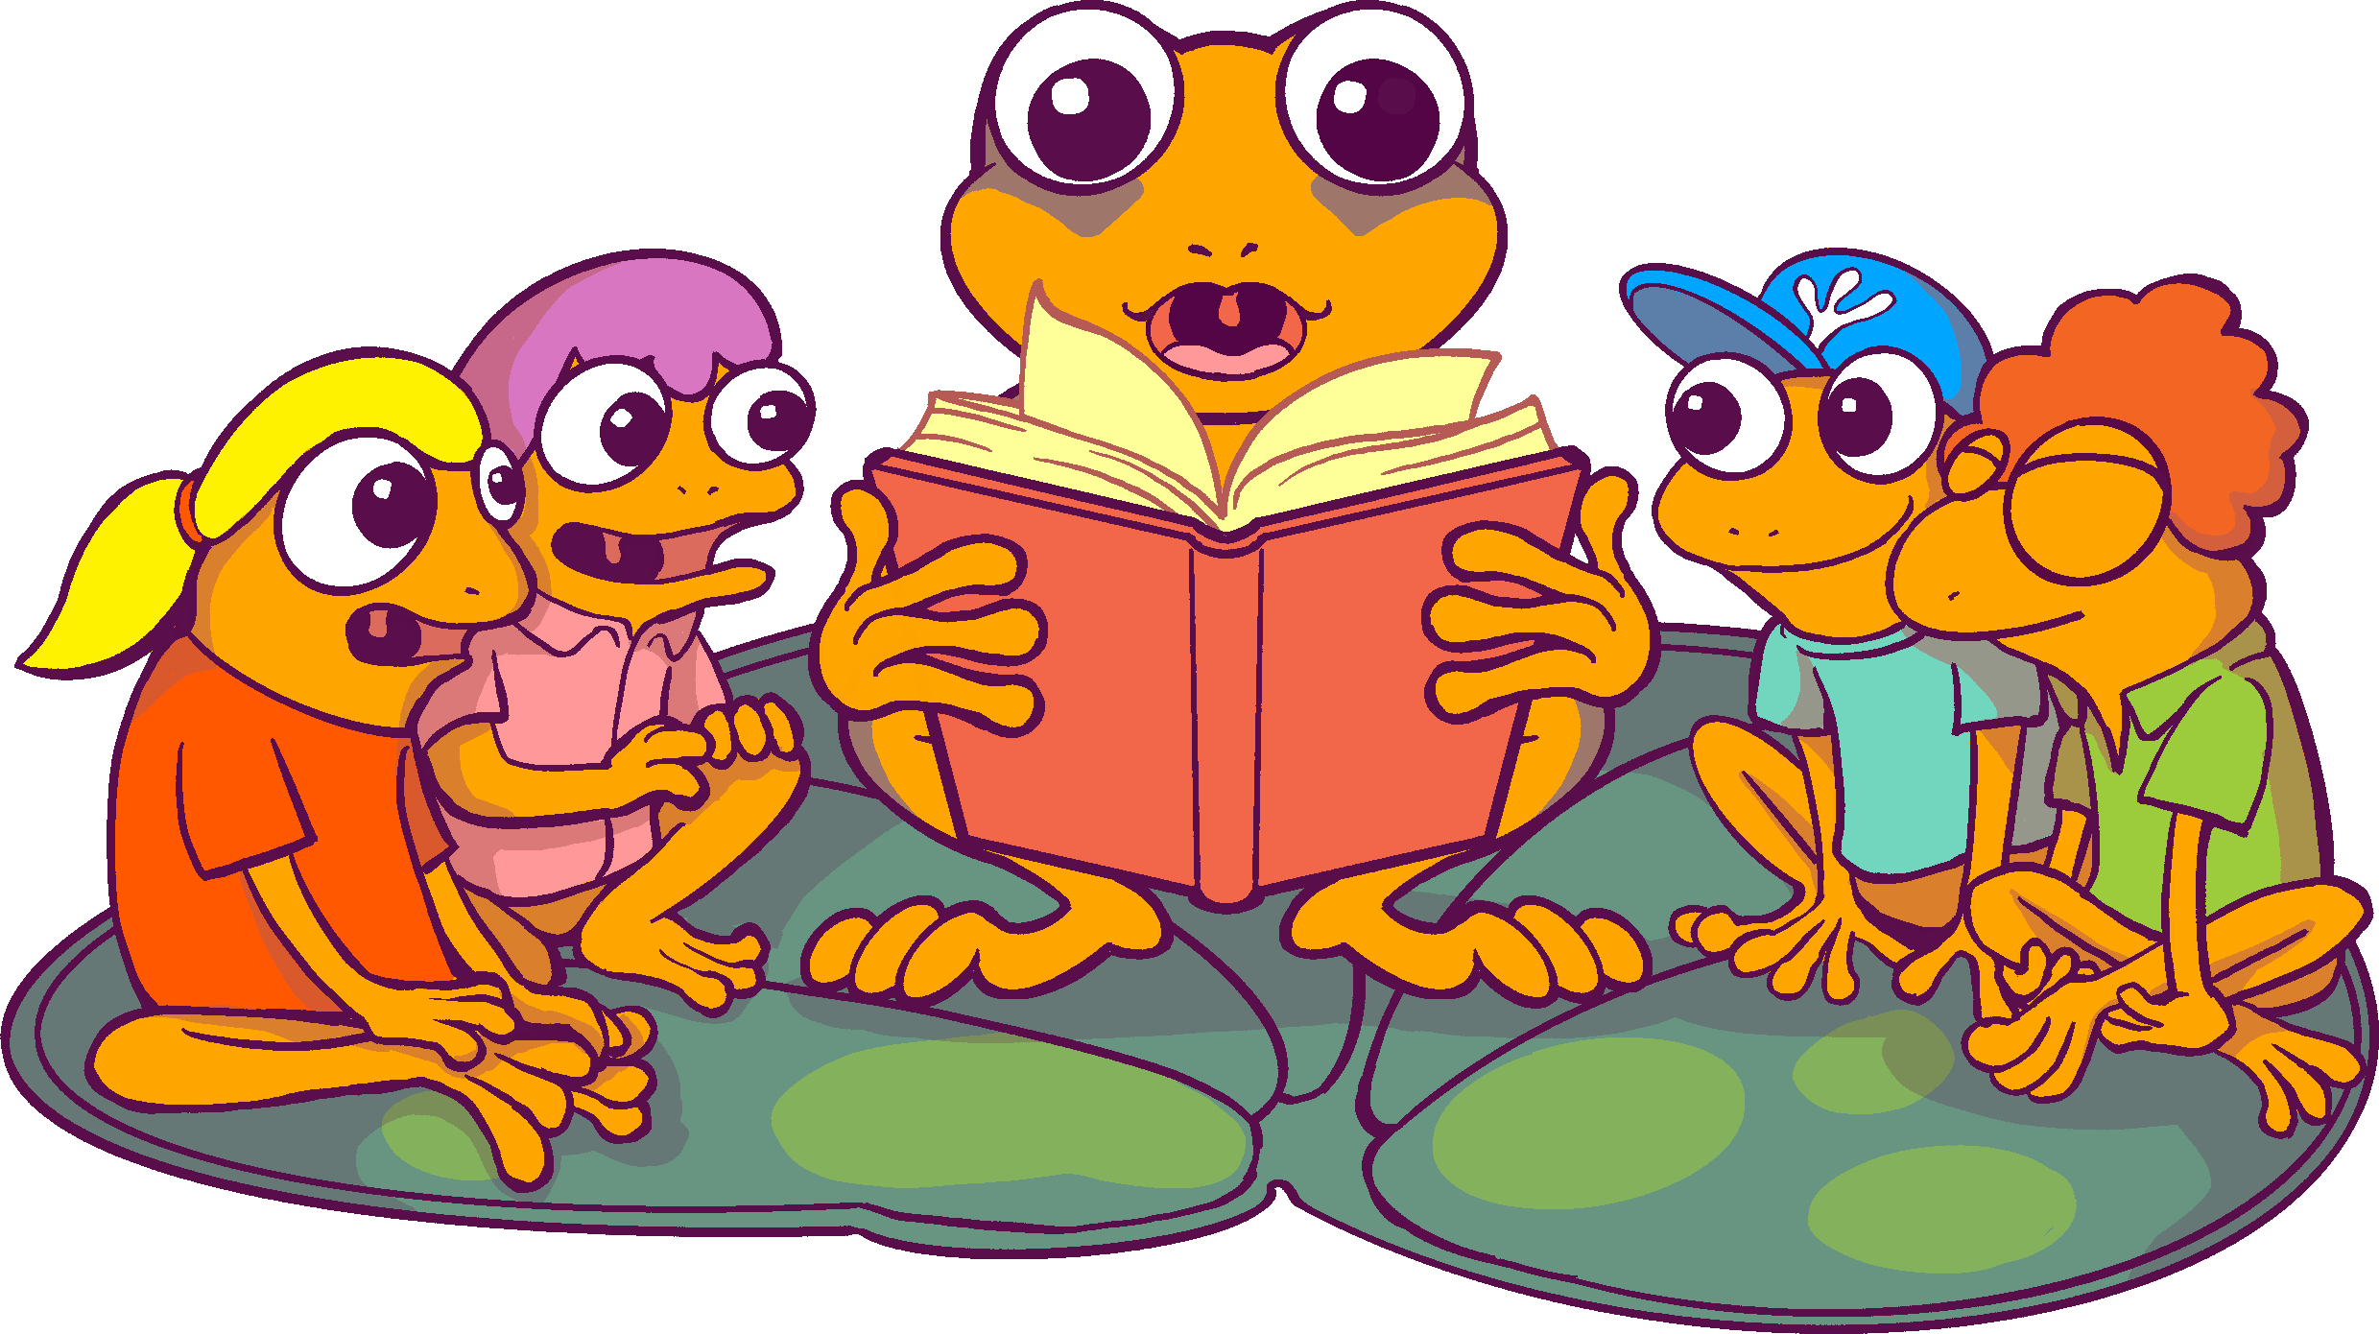
The Orange Frog
P 1
Learning Objective:
I can listen to the Orange Frog story.
I will discuss the Orange Frog story and see how it relates to me.
Notes:
Standard:
Essential Concept: Communicate and work productively with others emphasizing collaboration and cultural awareness to produce quality work.
Skill:
Interact positively as a team member.
Cooperate with others in a group setting.
Generate ideas with group members.
Are active listeners**
Read and understand information in a variety of forms.
Express ideas**

Slide 4
Skills
Interact positively as a team member.
Cooperate with others in a group setting.
Generate ideas with group members.
Be an active listener
Read and understand information in a variety of forms.
Express ideas

Slide 5
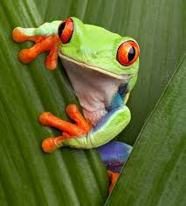
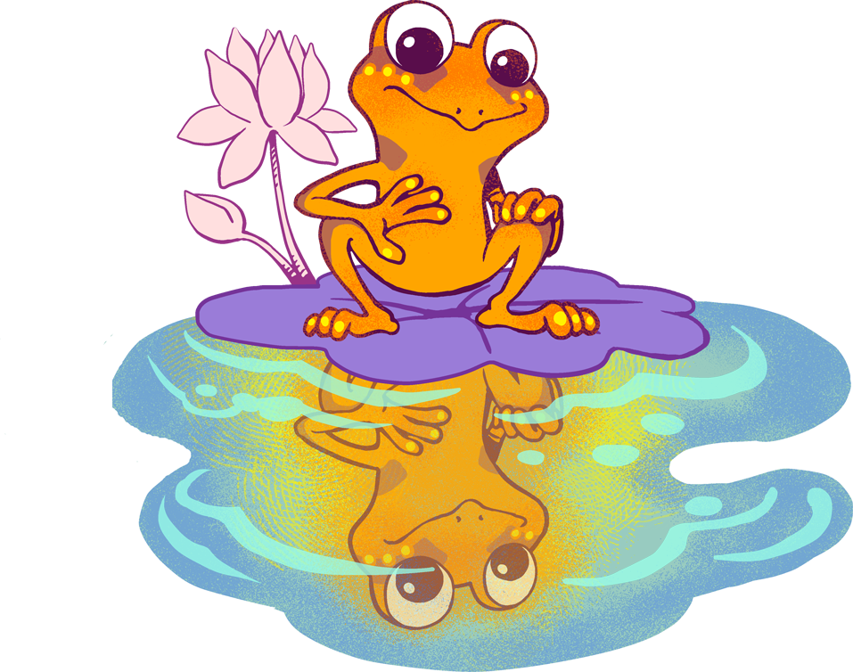
Questions
“When you hear the word positive, what do you think of?”
“What do you know about frogs? Are they happy?”
Are positive people happy?
Notes:
Facilitate discussion with students. When they seem to be wrapping it up, tell them, “We are going to read a story about a VERY interesting frog named Spark. Spark is going to teach us some important skills”.

Slide 6
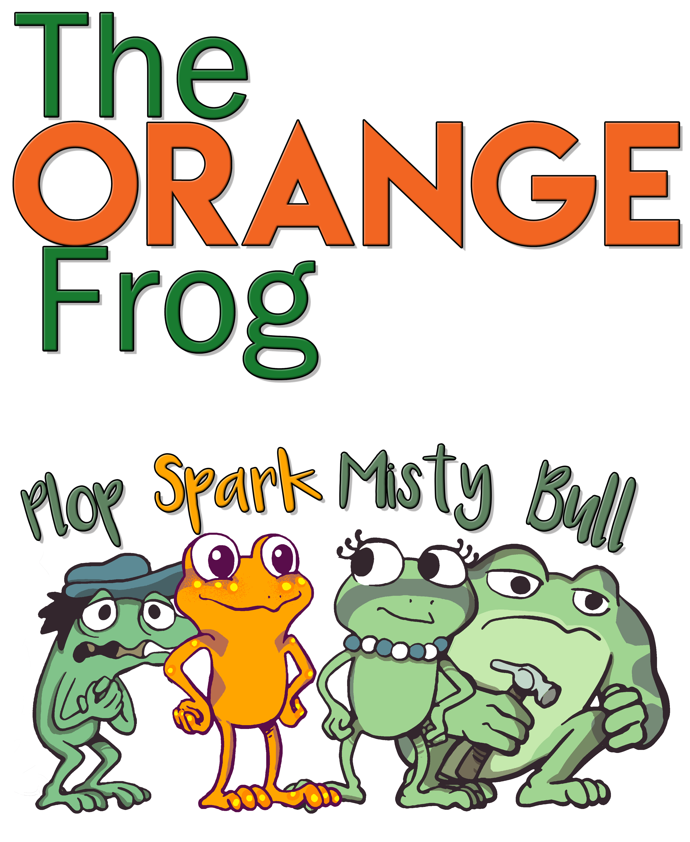

Slide 7
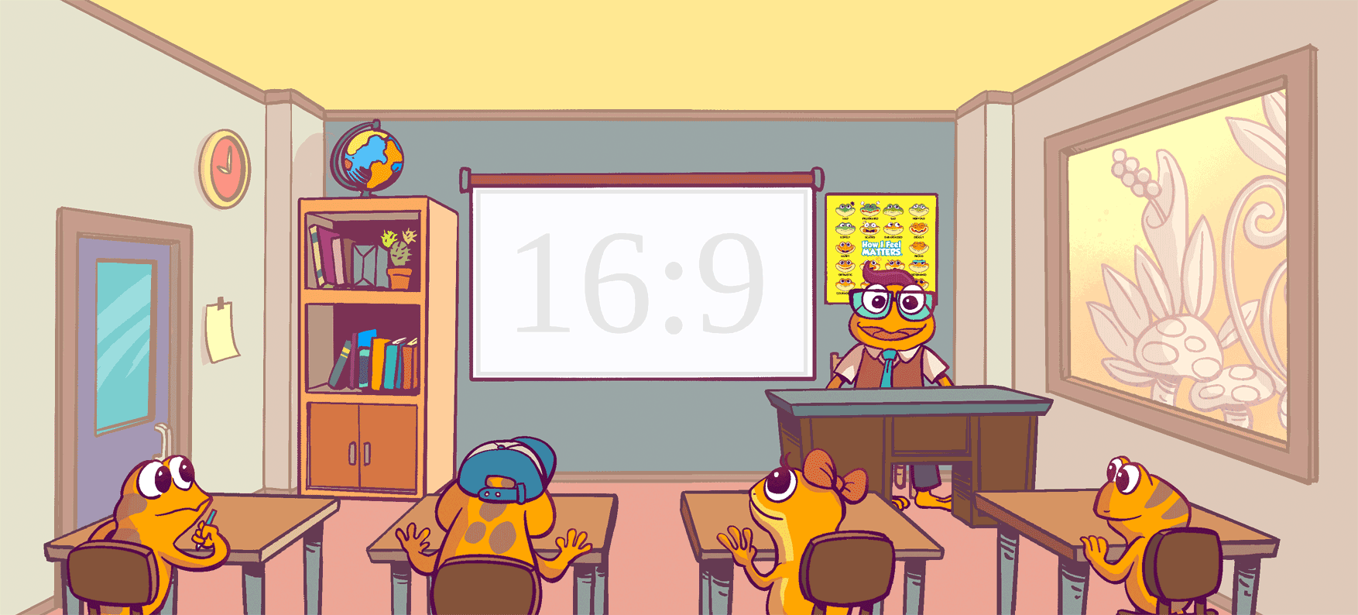
Introducing The Orange Frog
Notes:
Presenter Notes: Click forward to automatically play The Orange Frog Kid’s book. Click forward once more to view the video in full screen.

Slide 8
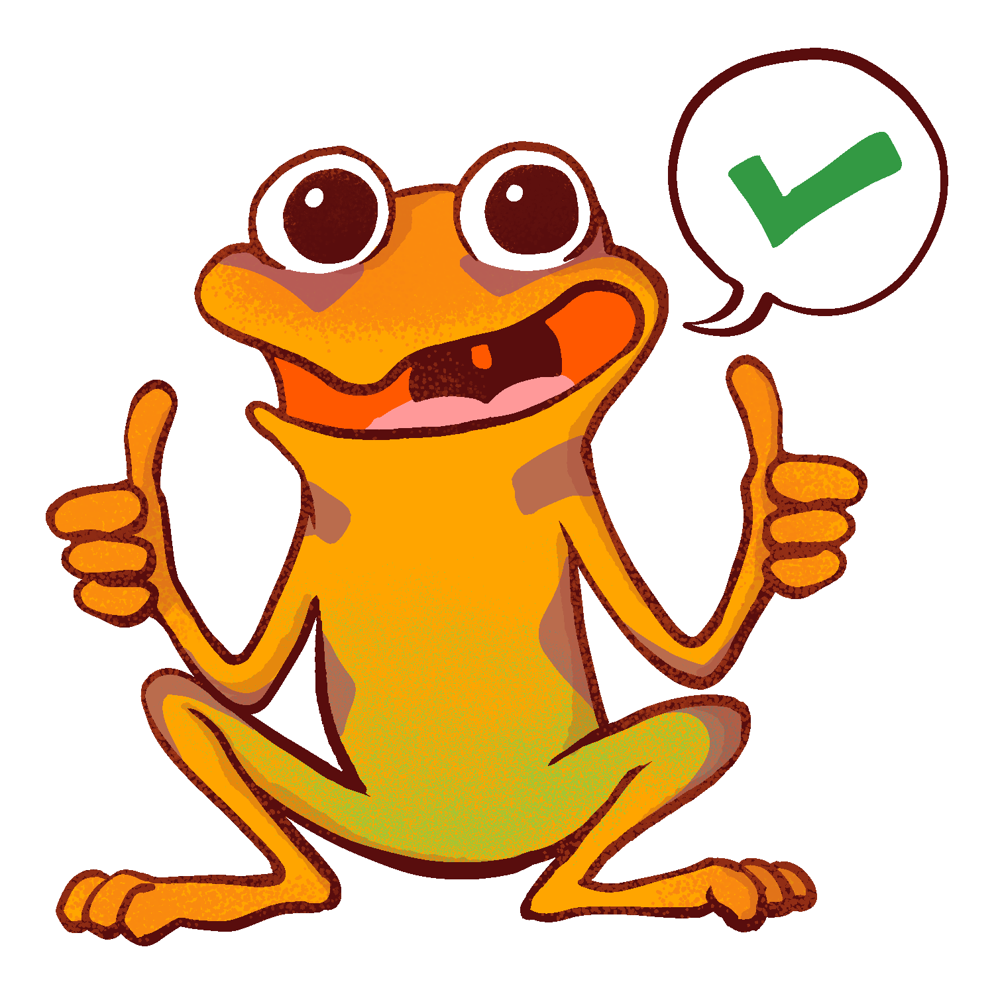
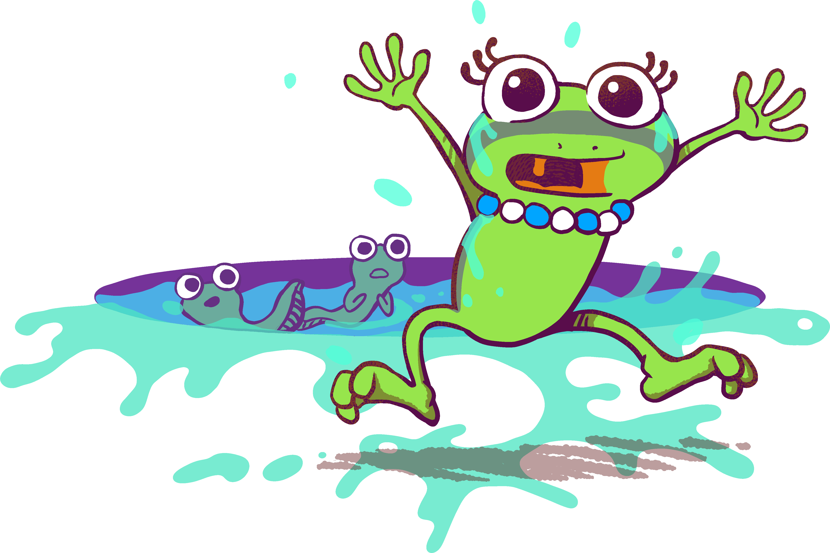
Thoughts
Misty | Plop | Bull
“I’ve been waiting so long to get to go hopping around this place”. | “In fact, he was nervous about lots of things”. | “All that matters is what I do”.
Fun loving, free spirit | Nervous, scared, anxious | Working, ignoring social interactions

Slide 9
Actions
Talk to your elbow partner and tell your partner which frog you feel most like…
… and say why you feel like that frog.
Notes:
Action:
Ask the students to have an elbow partner discussion -- “What frog are you like? When I think about the frogs, I think about their traits. I think about the things they have said (reference chart). I am most like _______, because ___________”.
**Example: “I am most like Bull, because I am the type of person that works every second of every day. I like to make sure all of my work is done and done correctly. I don’t care much about having fun”.

Slide 10
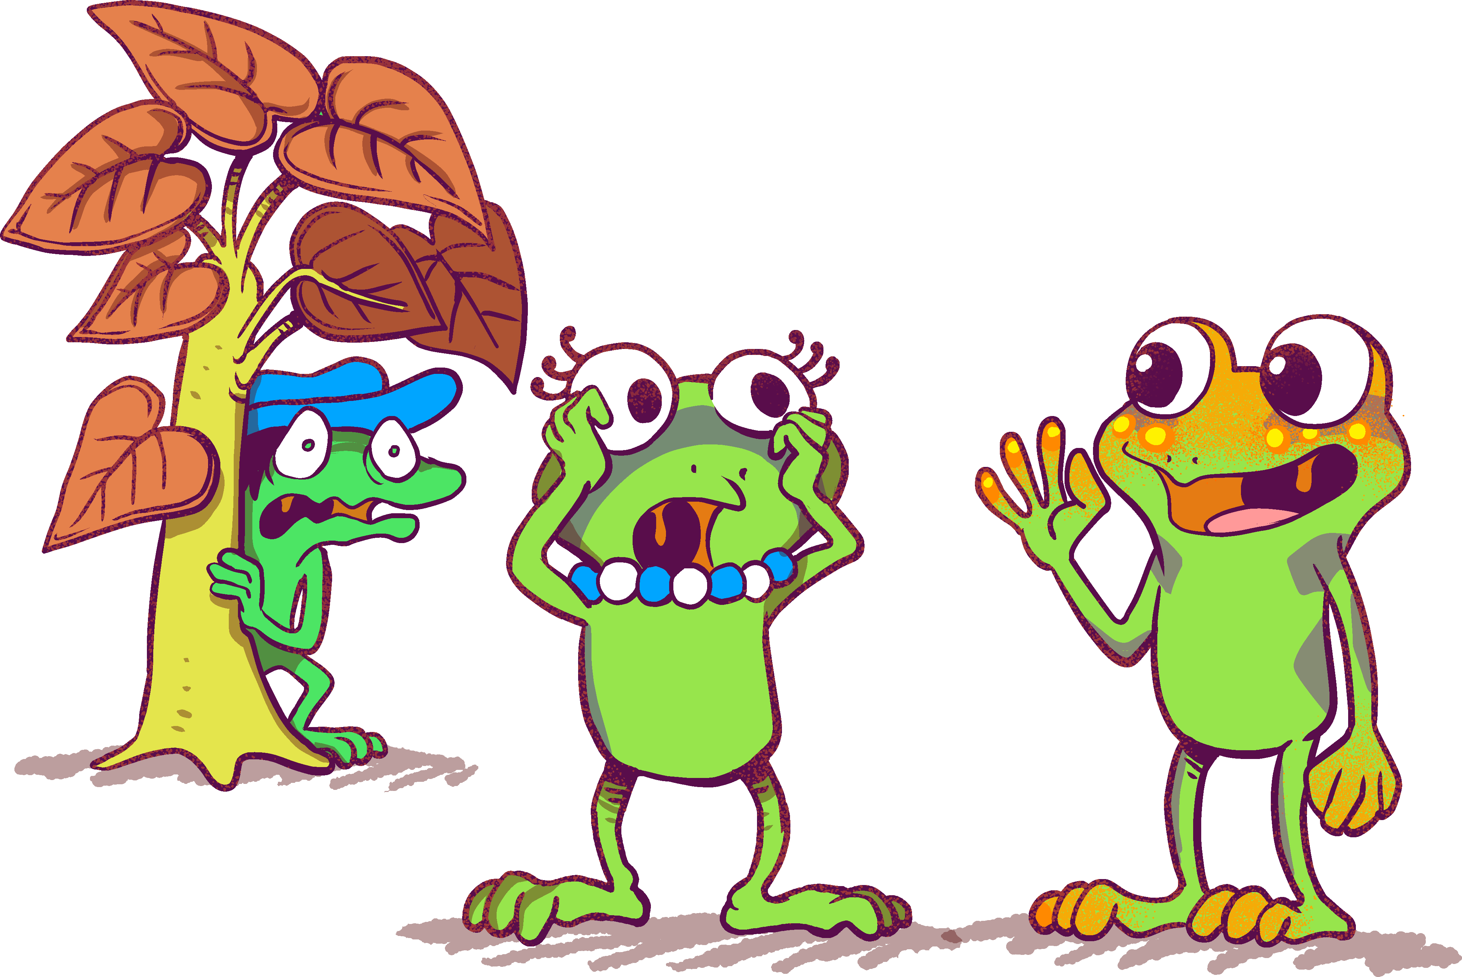
BONUS
When you see Plop shaking, and asking about Herons, do you think he is excited to see the Herons? Or nervous?
What do you think the Herons are?
Knowing what the other frogs are like… What kind of frog do you think Spark is?

